Slide 1
SOEN 384
Management, Measurement and Quality Control http://users.encs.concordia.ca/~s384_2/
Lecture 13:
Review for the Midterm Exam (2)

Slide 2
Agenda
Last class:
  Topic 1: Overview of project management applied to software development projects
  Topic 2: Some Classical Measures
  Topic 7: Software Project Quality management
soen384-F15-L13: review (2)

Slide 3
Agenda
Today:
  Topic 3: The Basics of Representational Theory of Measurement
  Topic 4: Simple measurement data analysis techniques
  Topic 5: Goal-Based Measurement (last tutorial)
  Topic 6: Software Measurement Program to be used in SOEN390/490
  Topic 8: Simple Effort Estimation techniques
  Topic 9: KA 1: Initiation and scope definition.
soen384-F15-L13: review (2)

Slide 4
Topic 3: Representational Theory of Measurement
Scale Types: Nominal, Ordinal, Interval, Ratio, Absolute.
  Give examples of each and understand the differences between the scale types.
Measurement scales and statistics relevant to each scale type
Meaningfulness
soen384-F15-L13: review (2)

Slide 5
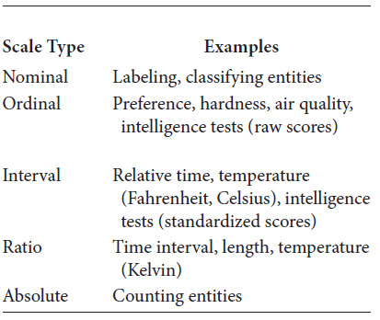
Examples. Understand the differences between the scale types
soen384-F15-L13: review (2)

Slide 6
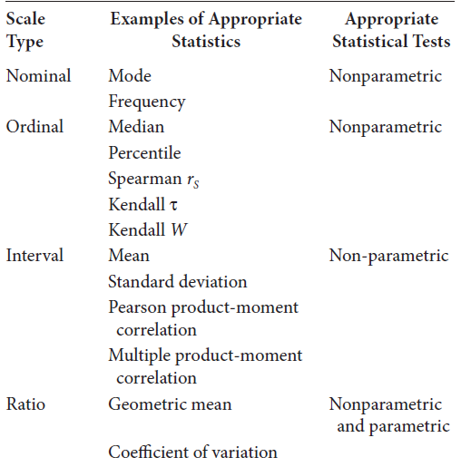
Summary of measurement scales and statistics relevant to each
soen384-F15-L13: review (2)

Slide 7
More exercises
See lecture 9
soen384-F15-L13: review (2)

Slide 8
Topic 4: Simple measurement data analysis techniques
Box plot technique (practiced in H2)
bar chart (practiced in H2)
control charts (practiced in H2)
kiviat graphs (practiced in A1, Logiscope)
pie graphs (practiced in A1, Logiscope)
soen384-F15-L13: review (2)

Slide 9
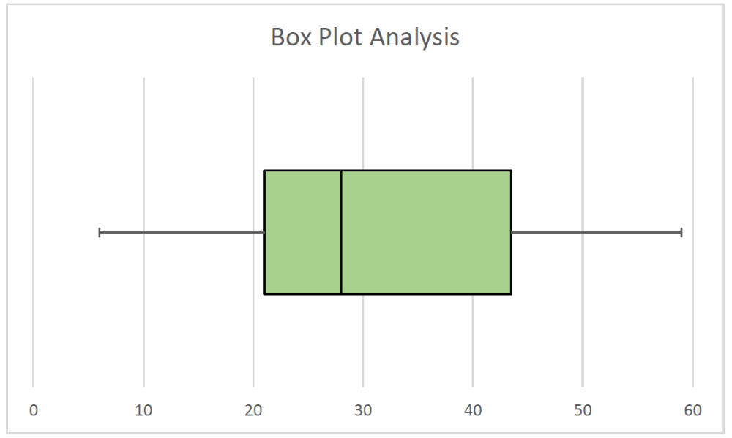

Homework 2 results:
Box Plot Analysis
Range of acceptable values
Quick review
Quick review
outliers
outliers
box plots point us to abnormal or unusual behavior in a data set. On the other hand, they can also help us to see what is usual or normal
soen384-F15-L13: review (2)

Slide 10
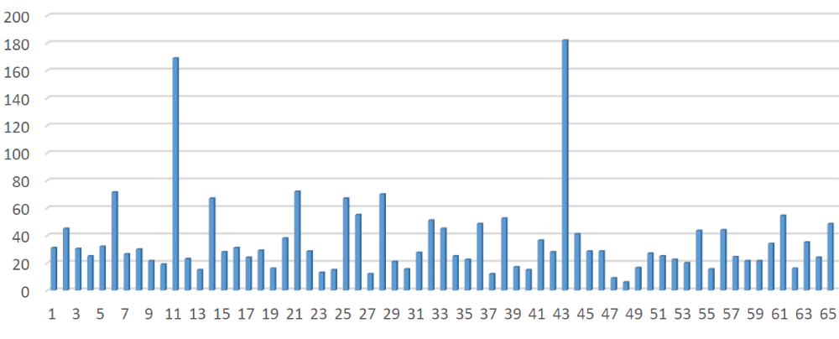
Homework 2 results:
Bar Chart Analysis
Bar Charts simply display all the data ordered to see what the patterns or trends may be.
They allow us to readily identify the entity associated with each measured value
soen384-F15-L13: review (2)

Slide 11
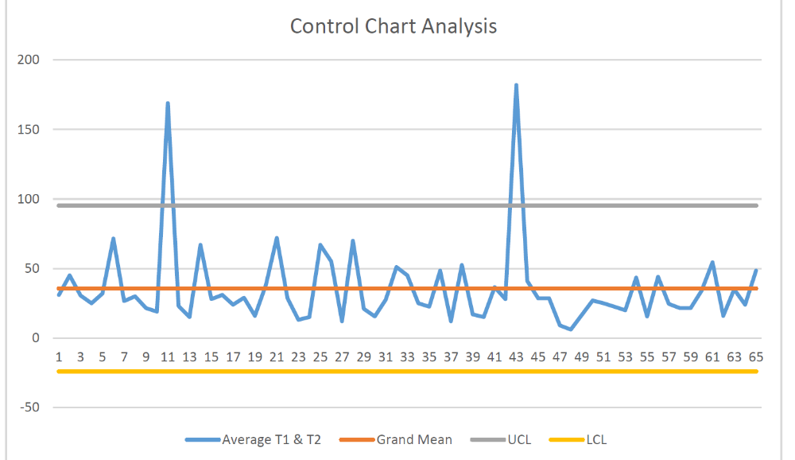
Homework 2 results:
Control Chart Analysis
The control limits act as guidelines for understanding
when the data are within random statistical variation and when they represent unusual behavior.
Results outside the control limits require further investigations
soen384-F15-L13: review (2)

Slide 12
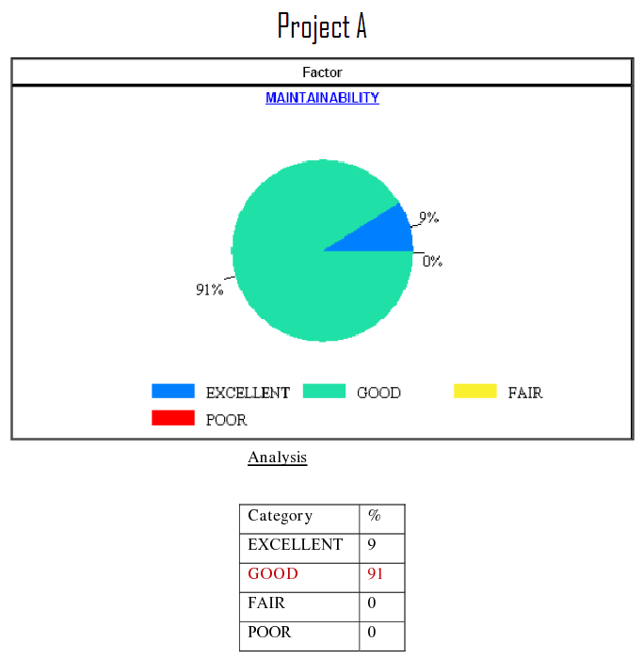
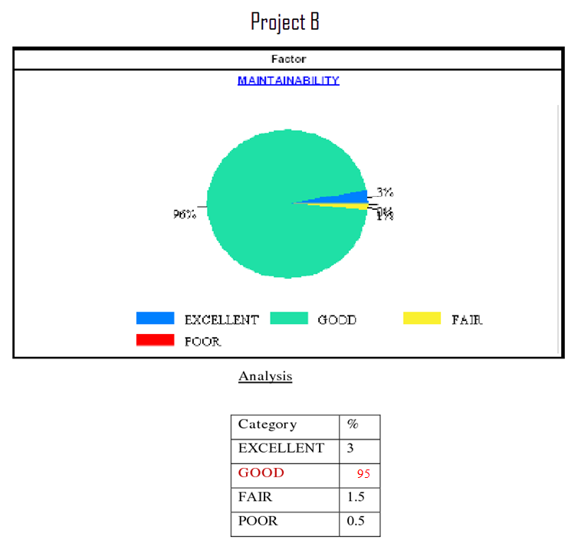
Sample question
Two capstone teams A and B used the LOGISCOPE tool to analyze the maintainability of their deliverables. Given the following LOGISCOPE results on maintainability levels, compare the maintainability of the projects A and B as observed from the following pie charts and the analysis tables and write your conclusions in the provided space:
soen384-F15-L13: review (2)

Slide 13
Topic 6: Software Measurement Program
Measurement goal #1: Increase customer satisfaction
Measurement goal #2: Deliver defect free versions
Measurement goal #3: Improve quality of code
soen384-F15-L13: review (2)

Slide 14
GOAL #1: Increase customer satisfaction
Question 1: what is the satisfaction of the user with specific system features?
  Indicator: the percentage of users who improved their scores for specific system features
  Measures : summed scores obtained from user satisfaction questionnaires
Question 2: what is the degree to which the user has confidence that the product will behave as intended?
  Indicator: the percentage of users who improved their confidence in the specific system features
  Measures: summed scores obtained from user confidence questionnaires
soen384-F15-L13: review (2)
Notes:
Measures: measurement data and the measurement data collection procedures

Slide 15
Topic 6: Software Measurement Program
Measurement goal #1: Increase customer satisfaction
Measurement goal #2: Deliver defect free versions
Measurement goal #3: Improve quality of code
soen384-F15-L13: review (2)

Slide 16
Goal #2: deliver defect free versions
ID | question | Indicator - Measurement formula
Q1 | How many bugs were reported per Sprint? | Total # of Bugs per Sprint
Q2 | How many of the bugs opened in production were not resolved or are pending per Sprint? | Total # of Bugs - (# of Fixed Bugs + # of False Positives) for each Sprint
Q3 | What is the proportion of bugs fixed per module of the software per Sprint? | (# of Bugs Fixed per Module / Total # of Bugs Fixed) * 100
Q4 | What was the progression of bugs open in production detected per Sprint? | Sum of bugs open in production per Sprint
Q5 | What percentage of the total effort to fix bugs was required to resolve the defects fixed in each module per Sprint? | # of Hours to Fix Defects for Module / Total # Hours Spent Fixing Defects
soen384-F15-L13: review (2)

Slide 17
Goal #2: deliver defect free versions
  Measurements:
ID | Measures
M1 | Number or open bugs per Sprint
M2 | Number of fixed bugs per Sprint
M3 | Number of false positives per Sprint
M4 | Number of fixed bugs per module
M5 | Number of person-hours to fix defects per module
M6 | Total number of person-hours to fix defects per Sprint
soen384-F15-L13: review (2)

Slide 18
Topic 6: Software Measurement Program
Measurement goal #1: Increase customer satisfaction
Measurement goal #2: Deliver defect free versions
Measurement goal #3: Improve quality of code
soen384-F15-L13: review (2)

Slide 19
Goal #3: Improve quality of code
Question 1: what is the code maintainability trend of the proejct?
  Indicator: Logiscope maintainability pie charts. Rank the quality of the code in different milestones reported in the class factor or criteria level.
  Measures: Maintainability Class Factor Level and Maintainability Class Criteria Level
Question 2: what is the code testability trend of the project?
  Indicator: Average McCabe cyclomatic complexity line charts Measure: Cyclomatic complexity
Question 3: how much unstructured logic exists in the project?
  Indicator: Average essential complexity line charts
  Measure: Essential complexity
soen384-F15-L13: review (2)

Slide 20
Topic 8: Simple Effort Estimation techniques
Simple Effort Estimation techniques
Team Effort Estimate for a Project: steps
How to Compare Estimated Effort to Actual Effort? Magnitude of Relative Error (MRE)
Cone of uncertainty
How to Use Feature’s Estimated Effort to calculate individual tasks effort?
soen384-F15-L13: review (2)

Slide 21
Sample questions
Your capstone team is assigned to develop a new library management system. Which of the methods seen in class would you choose for effort estimation purposes?
  Individual Expert Judgment Method
  Analogy Method
  T-shirt
soen384-F15-L13: review (2)

Slide 22
How would you know that your project was well-estimated?
Calculates the Magnitude of Relative Error (MRE), which measures for a given project the difference between actual and estimated effort relative to the actual effort.
The mean takes into account the numerical value of every observation in the data distribution
Interpretation:
  recommended is +-25%
  Perfect estimate : MRE=0%
soen384-F15-L13: review (2)

Slide 23
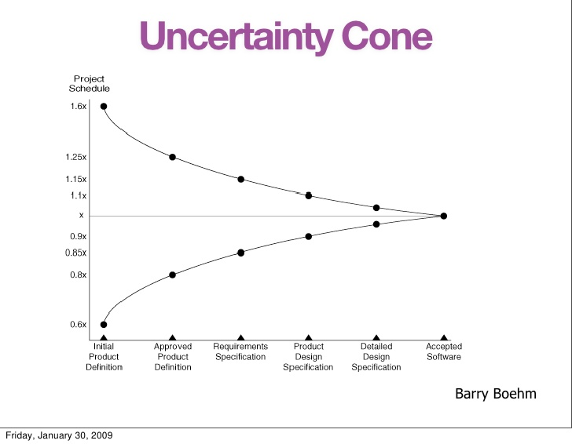
Explain the notion of “Cone of uncertainty” in software project effort estimation
At the beginning of a project, comparatively little is known about the product or work results, and so estimates are subject to large uncertainty.
As more research and development is done, more information is learned about the project, and the uncertainty then tends to decrease, reaching 0% when all residual risk has been terminated or transferred.
soen384-F15-L13: review (2)

Slide 24
Topic 9: Management Key Area (KA) 1: Initiation and scope definition.
1.1. Determination and Negotiation of Requirements
1.2. Feasibility Analysis using Project Scope Ratio formula
1.3. Process for the Review and Revision of Requirements
soen384-F15-L13: review (2)

Slide 25
Sample questions
  What is project scope? Explain briefly how to use effort estimation, time (schedule) and resources (number of developers) to verify project scope.
  A team of ten soen390 students is working for twelve weeks in a project, 4 hours of work per week. The estimated amount of work required to complete the scheduled activities is 520 person-hours. Verify the project scope and state clearly your conclusions and recommendations.
soen384-F15-L13: review (2)

Slide 26
Next?
Tutorial: discussion of the sample questions’ solutions
Midterm: in class, closed book, 1h15min
GOOD LUCK !!!
soen384-F15-L13: review (2)

